Slide 1


Decadal predictions for the energy-sector
Ben Hutchins – 1st July 2024
RMetS Early Career and Student Conference
Supervisors: David Brayshaw, Len Shaffrey, Hazel Thornton, Doug Smith
Notes:
Three main points:
As power systems are changing they are becoming more sensitive to variations in the weather and climate.
Decadal predictions can be used to forecast how climate variables (e.g. temperature, NAO, delta P) will evolve over the next 10 years.
Decadal predictions can be used to aggregate a larger sample of extreme weather/climate events than are available in observations.

Slide 2

Overview
Motivation
Decadal forecasts for the energy sector
Decadal predictions for sampling extremes
Potential applications
Next steps
Notes:
As we deploy more renewable electricity sources in the power system, such as wind turbines and solar panels, the system becomes more vulnerable to both climate variability and climate change.
Decadal forecasts try to capture signal from both internal climate variability and externally forced signals, so could be useful for the energy-sector
They are initialised with the current state of the atmosphere and oceans each year, in the same way as NWP forecasts
As they are run forward for a decade, they also have prescribed forcings, such as those from greenhouse gases and aerosols, in the same way as climate projections.
Recent work, such as that from Doug Smith in 2020, demonstrated surprising skill for predicting circulation over the North Atlantic, by making skillful predictions of the North Atlantic Oscillation, the pressure gradient over the North Atlantic region
My project looks into whether we can make use of the skill to create decadal predictions for the energy sector
Note that this figure is from Doug’s 2020 paper and therefore different to mine.
Bloomfield, H.C., Brayshaw, D.J., Shaffrey, L.C., Coker, P.J., Thornton, H.E., 2016. Quantifying the increasing sensitivity of power systems to climate variability. Environ. Res. Lett. 11, 124025. https://doi.org/10.1088/1748-9326/11/12/124025
Bloomfield, H.C., Brayshaw, D.J., Troccoli, A., Goodess, C.M., De Felice, M., Dubus, L., Bett, P.E., Saint-Drenan, Y.-M., 2021. Quantifying the sensitivity of european power systems to energy scenarios and climate change projections. Renewable Energy 164, 1062–1075. https://doi.org/10.1016/j.renene.2020.09.125
Smith, D.M., Eade, R., Scaife, A.A., Caron, L.-P., Danabasoglu, G., DelSole, T.M., Delworth, T., Doblas-Reyes, F.J., Dunstone, N.J., Hermanson, L., Kharin, V., Kimoto, M., Merryfield, W.J., Mochizuki, T., Müller, W.A., Pohlmann, H., Yeager, S., Yang, X., 2019. Robust skill of decadal climate predictions. npj Clim Atmos Sci 2, 1–10. https://doi.org/10.1038/s41612-019-0071-y
Smith, D.M., Scaife, A.A., Eade, R., Athanasiadis, P., Bellucci, A., Bethke, I., Bilbao, R., Borchert, L.F., Caron, L.-P., Counillon, F., Danabasoglu, G., Delworth, T., Doblas-Reyes, F.J., Dunstone, N.J., Estella-Perez, V., Flavoni, S., Hermanson, L., Keenlyside, N., Kharin, V., Kimoto, M., Merryfield, W.J., Mignot, J., Mochizuki, T., Modali, K., Monerie, P.-A., Müller, W.A., Nicolí, D., Ortega, P., Pankatz, K., Pohlmann, H., Robson, J., Ruggieri, P., Sospedra-Alfonso, R., Swingedouw, D., Wang, Y., Wild, S., Yeager, S., Yang, X., Zhang, L., 2020. North Atlantic climate far more predictable than models imply. Nature 583, 796–800. https://doi.org/10.1038/s41586-020-2525-0
Boer, G.J., Smith, D.M., Cassou, C., Doblas-Reyes, F., Danabasoglu, G., Kirtman, B., Kushnir, Y., Kimoto, M., Meehl, G.A., Msadek, R., Mueller, W.A., Taylor, K.E., Zwiers, F., Rixen, M., Ruprich-Robert, Y., Eade, R., 2016. The Decadal Climate Prediction Project (DCPP) contribution to CMIP6. Geoscientific Model Development 9, 3751–3777. https://doi.org/10.5194/gmd-9-3751-2016

Slide 3
A rapidly transitioning power system
Reducing fossil fuels
Developing renewable generation
Electrifying transport and heating
Building more electricity storage
Climate change
Climate variability
Extreme weather

Slide 4
Research questions
How can decadal forecasts be used to predict the evolution of climate variables over the next 10 years?
How can decadal predictions be used to aggregate extreme events for the energy sector?
How can we develop energy sector relevant applications for decadal forecasts?

Slide 5
Research questions
How can decadal forecasts be used to predict the evolution of climate variables over the next 10 years?
How can decadal predictions be used to aggregate extreme events for the energy sector?
How can we develop energy sector relevant applications for decadal forecasts?

Slide 6
Overview
Motivation
Decadal forecasts for the energy sector
Decadal predictions for sampling extremes
Challenges
Next steps
Notes:
As we deploy more renewable electricity sources in the power system, such as wind turbines and solar panels, the system becomes more vulnerable to both climate variability and climate change.
Decadal forecasts try to capture signal from both internal climate variability and externally forced signals, so could be useful for the energy-sector
They are initialised with the current state of the atmosphere and oceans each year, in the same way as NWP forecasts
As they are run forward for a decade, they also have prescribed forcings, such as those from greenhouse gases and aerosols, in the same way as climate projections.
Recent work, such as that from Doug Smith in 2020, demonstrated surprising skill for predicting circulation over the North Atlantic, by making skillful predictions of the North Atlantic Oscillation, the pressure gradient over the North Atlantic region
My project looks into whether we can make use of the skill to create decadal predictions for the energy sector
Note that this figure is from Doug’s 2020 paper and therefore different to mine.
Bloomfield, H.C., Brayshaw, D.J., Shaffrey, L.C., Coker, P.J., Thornton, H.E., 2016. Quantifying the increasing sensitivity of power systems to climate variability. Environ. Res. Lett. 11, 124025. https://doi.org/10.1088/1748-9326/11/12/124025
Bloomfield, H.C., Brayshaw, D.J., Troccoli, A., Goodess, C.M., De Felice, M., Dubus, L., Bett, P.E., Saint-Drenan, Y.-M., 2021. Quantifying the sensitivity of european power systems to energy scenarios and climate change projections. Renewable Energy 164, 1062–1075. https://doi.org/10.1016/j.renene.2020.09.125
Smith, D.M., Eade, R., Scaife, A.A., Caron, L.-P., Danabasoglu, G., DelSole, T.M., Delworth, T., Doblas-Reyes, F.J., Dunstone, N.J., Hermanson, L., Kharin, V., Kimoto, M., Merryfield, W.J., Mochizuki, T., Müller, W.A., Pohlmann, H., Yeager, S., Yang, X., 2019. Robust skill of decadal climate predictions. npj Clim Atmos Sci 2, 1–10. https://doi.org/10.1038/s41612-019-0071-y
Smith, D.M., Scaife, A.A., Eade, R., Athanasiadis, P., Bellucci, A., Bethke, I., Bilbao, R., Borchert, L.F., Caron, L.-P., Counillon, F., Danabasoglu, G., Delworth, T., Doblas-Reyes, F.J., Dunstone, N.J., Estella-Perez, V., Flavoni, S., Hermanson, L., Keenlyside, N., Kharin, V., Kimoto, M., Merryfield, W.J., Mignot, J., Mochizuki, T., Modali, K., Monerie, P.-A., Müller, W.A., Nicolí, D., Ortega, P., Pankatz, K., Pohlmann, H., Robson, J., Ruggieri, P., Sospedra-Alfonso, R., Swingedouw, D., Wang, Y., Wild, S., Yeager, S., Yang, X., Zhang, L., 2020. North Atlantic climate far more predictable than models imply. Nature 583, 796–800. https://doi.org/10.1038/s41586-020-2525-0
Boer, G.J., Smith, D.M., Cassou, C., Doblas-Reyes, F., Danabasoglu, G., Kirtman, B., Kushnir, Y., Kimoto, M., Meehl, G.A., Msadek, R., Mueller, W.A., Taylor, K.E., Zwiers, F., Rixen, M., Ruprich-Robert, Y., Eade, R., 2016. The Decadal Climate Prediction Project (DCPP) contribution to CMIP6. Geoscientific Model Development 9, 3751–3777. https://doi.org/10.5194/gmd-9-3751-2016

Slide 7
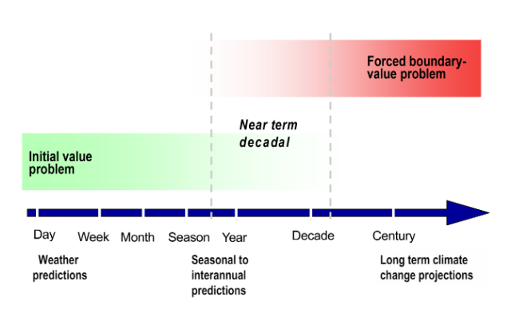
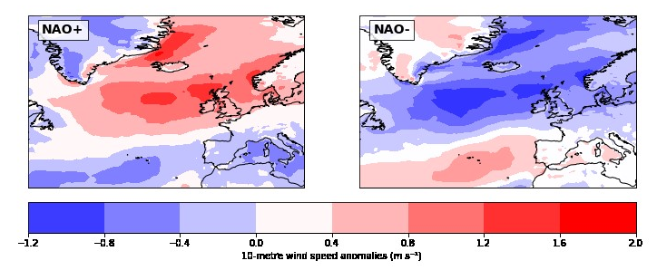

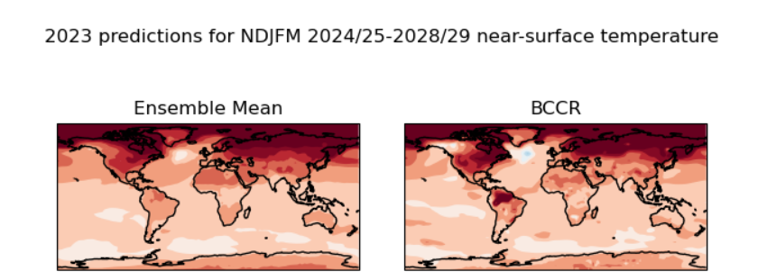
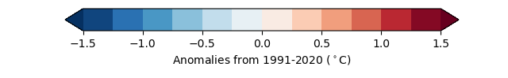
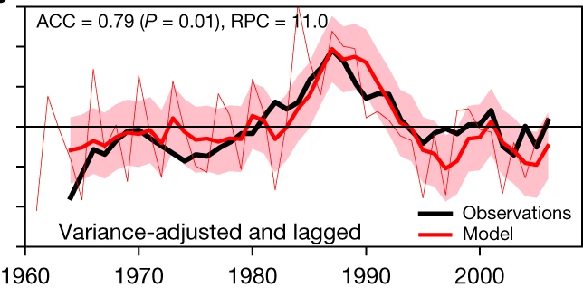
How can we use decadal forecasts?
10m wind speed anomalies, DJFM
Initialized climate projections
Climate variability
Climate change
Surface variables (e.g. temperature)
Atmospheric circulation (e.g. NAO)
“It is likely (80% chance) that global mean near-surface temperature will exceed 1.5°C above the 1850-1900 average levels for at least one year between 2024 and 2028.”
NAO anomaly (hPa)
Boer et al. 2016, WMO 2024, Smith et al. 2020
Notes:
Reference for UKMO WMOLC GADCU stuff
Reference for Doug paper

Slide 8
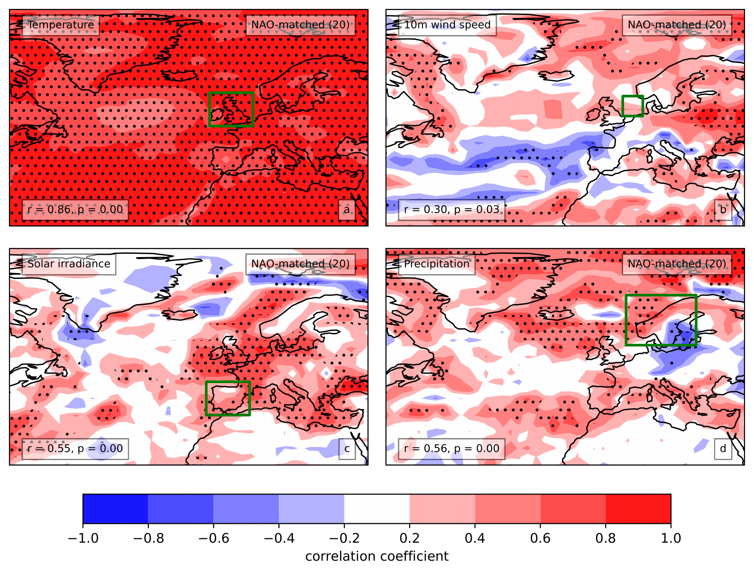
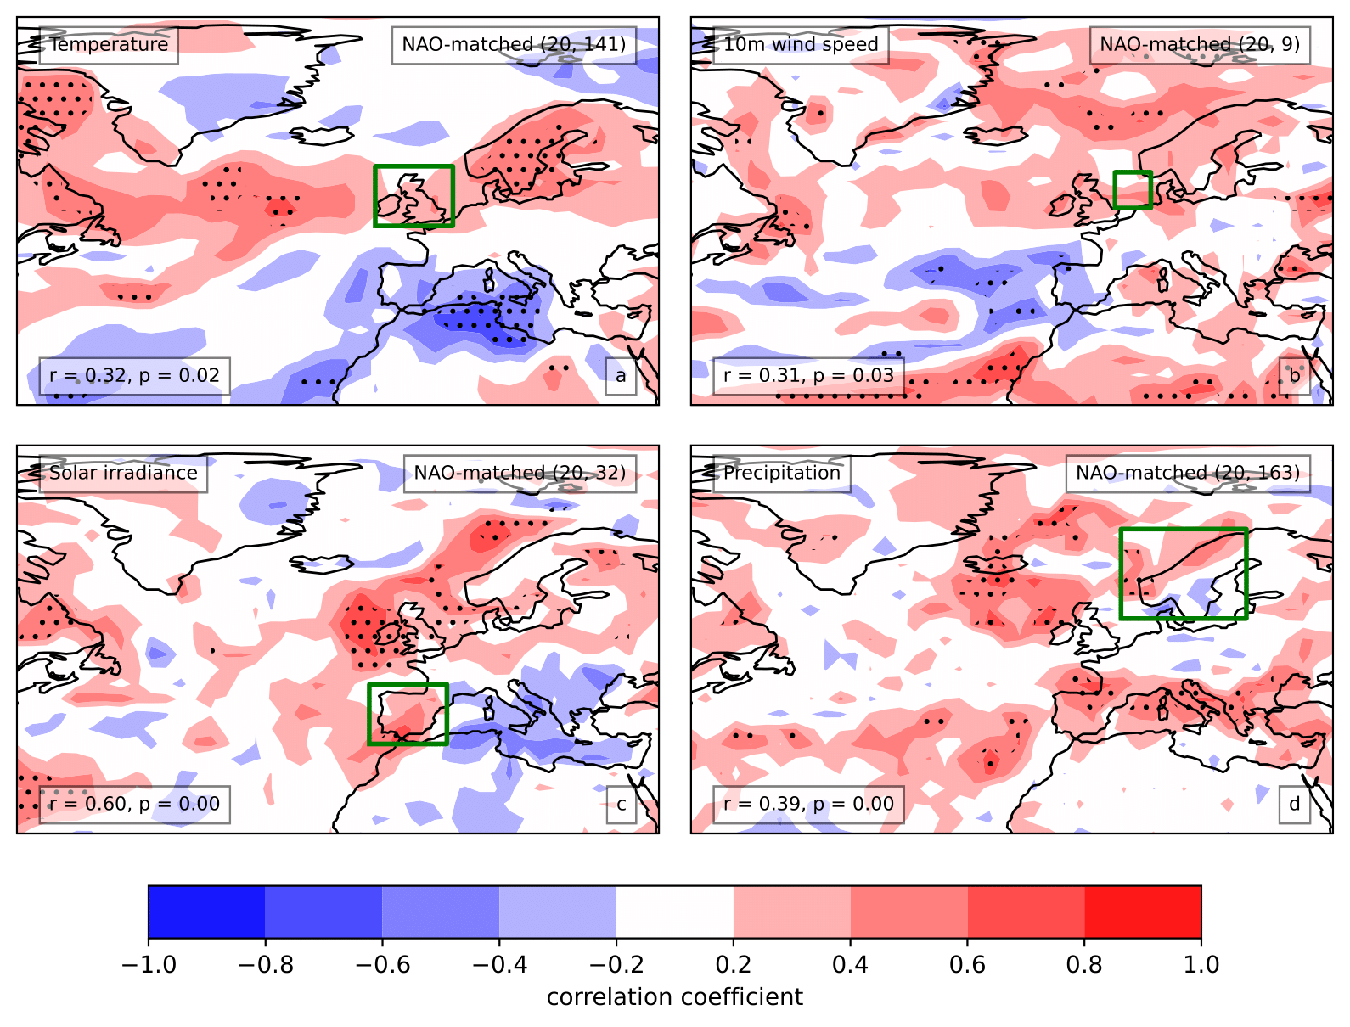
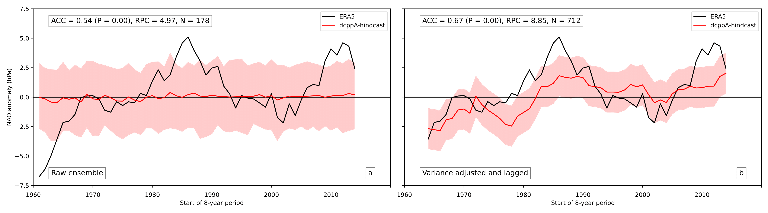
How much skill is there in decadal predictions?
Forecast years 2-9, ONDJFM, residual skill
Forecast years 2-9, ONDJFM, total skill
Predicting atmospheric circulation (e.g. NAO)
Small predictable signal
Adjust via RPS (signal-to-noise)
Surface variables
NAO-matching
Detrended skill
NAO: forecast years 2-9, ONDJFM
Notes:
Include SLP skill in supp. Material slides

Slide 9
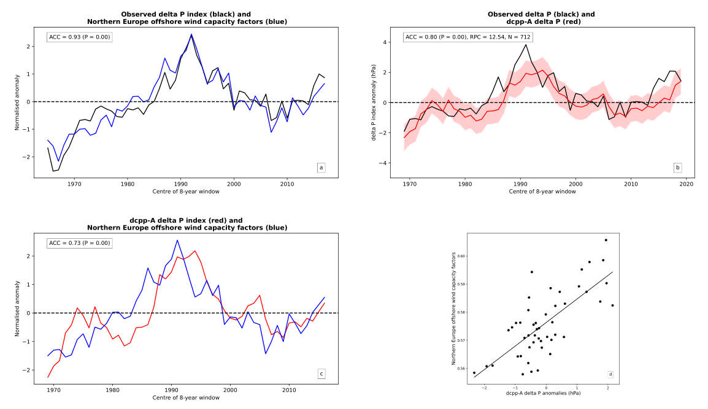
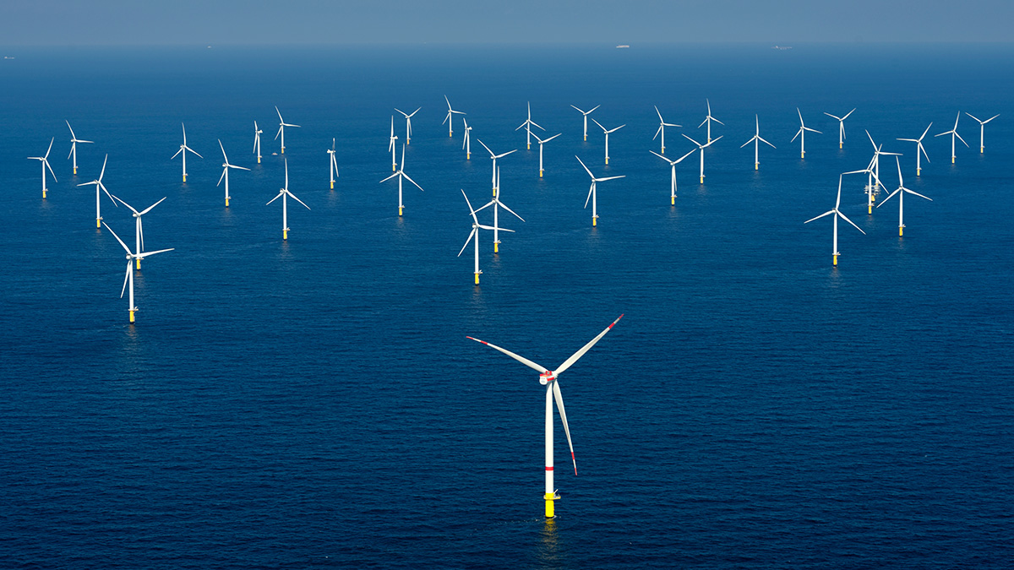
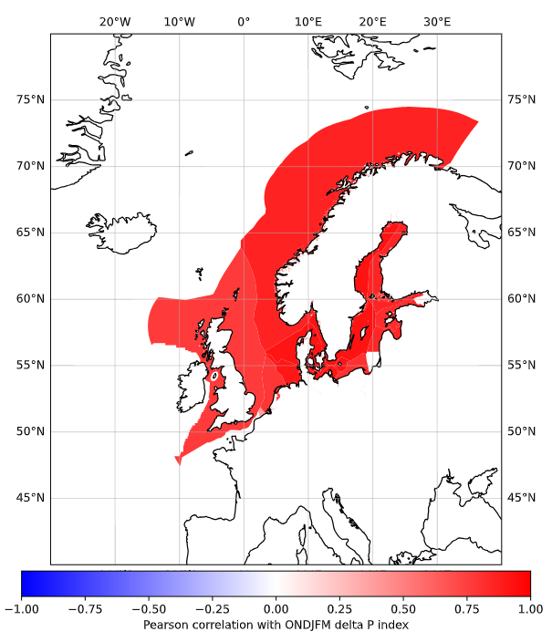
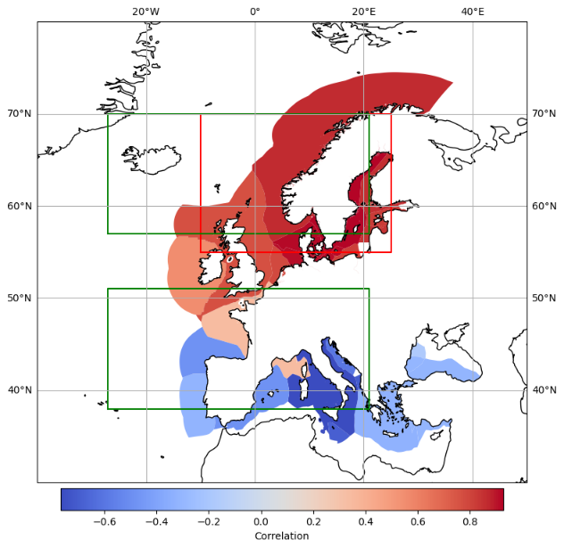
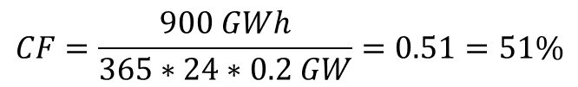
Can we use decadal forecasts for energy?
corr(obs. delta P, offshore wind CF.’s)
Offshore wind capacity factors
Delta P -> pressure gradient over UK (green boxes)
Northern Europe region
Observed relationship
Prediction skill of index
Energy variable skill
$$CF=\frac{900 GWh}{365∗24∗0.2 GW}=0.51=51\%$$
Notes:
Define capacity factors – the proportion of generation from wind turbines, relative to their rated capacity
Or from Wikipedia - ratio of actual electrical energy output over a given period of time (normally a year) to the theoretical maximum electrical energy output over that period (again, normally a year)
Delta P measures the strength of the westerly over southern UK

Slide 10
Overview
Motivation
Decadal forecasts for the energy sector
Decadal predictions for sampling extremes
Challenges
Next steps
Notes:
As we deploy more renewable electricity sources in the power system, such as wind turbines and solar panels, the system becomes more vulnerable to both climate variability and climate change.
Decadal forecasts try to capture signal from both internal climate variability and externally forced signals, so could be useful for the energy-sector
They are initialised with the current state of the atmosphere and oceans each year, in the same way as NWP forecasts
As they are run forward for a decade, they also have prescribed forcings, such as those from greenhouse gases and aerosols, in the same way as climate projections.
Recent work, such as that from Doug Smith in 2020, demonstrated surprising skill for predicting circulation over the North Atlantic, by making skillful predictions of the North Atlantic Oscillation, the pressure gradient over the North Atlantic region
My project looks into whether we can make use of the skill to create decadal predictions for the energy sector
Note that this figure is from Doug’s 2020 paper and therefore different to mine.
Bloomfield, H.C., Brayshaw, D.J., Shaffrey, L.C., Coker, P.J., Thornton, H.E., 2016. Quantifying the increasing sensitivity of power systems to climate variability. Environ. Res. Lett. 11, 124025. https://doi.org/10.1088/1748-9326/11/12/124025
Bloomfield, H.C., Brayshaw, D.J., Troccoli, A., Goodess, C.M., De Felice, M., Dubus, L., Bett, P.E., Saint-Drenan, Y.-M., 2021. Quantifying the sensitivity of european power systems to energy scenarios and climate change projections. Renewable Energy 164, 1062–1075. https://doi.org/10.1016/j.renene.2020.09.125
Smith, D.M., Eade, R., Scaife, A.A., Caron, L.-P., Danabasoglu, G., DelSole, T.M., Delworth, T., Doblas-Reyes, F.J., Dunstone, N.J., Hermanson, L., Kharin, V., Kimoto, M., Merryfield, W.J., Mochizuki, T., Müller, W.A., Pohlmann, H., Yeager, S., Yang, X., 2019. Robust skill of decadal climate predictions. npj Clim Atmos Sci 2, 1–10. https://doi.org/10.1038/s41612-019-0071-y
Smith, D.M., Scaife, A.A., Eade, R., Athanasiadis, P., Bellucci, A., Bethke, I., Bilbao, R., Borchert, L.F., Caron, L.-P., Counillon, F., Danabasoglu, G., Delworth, T., Doblas-Reyes, F.J., Dunstone, N.J., Estella-Perez, V., Flavoni, S., Hermanson, L., Keenlyside, N., Kharin, V., Kimoto, M., Merryfield, W.J., Mignot, J., Mochizuki, T., Modali, K., Monerie, P.-A., Müller, W.A., Nicolí, D., Ortega, P., Pankatz, K., Pohlmann, H., Robson, J., Ruggieri, P., Sospedra-Alfonso, R., Swingedouw, D., Wang, Y., Wild, S., Yeager, S., Yang, X., Zhang, L., 2020. North Atlantic climate far more predictable than models imply. Nature 583, 796–800. https://doi.org/10.1038/s41586-020-2525-0
Boer, G.J., Smith, D.M., Cassou, C., Doblas-Reyes, F., Danabasoglu, G., Kirtman, B., Kushnir, Y., Kimoto, M., Meehl, G.A., Msadek, R., Mueller, W.A., Taylor, K.E., Zwiers, F., Rixen, M., Ruprich-Robert, Y., Eade, R., 2016. The Decadal Climate Prediction Project (DCPP) contribution to CMIP6. Geoscientific Model Development 9, 3751–3777. https://doi.org/10.5194/gmd-9-3751-2016

Slide 11
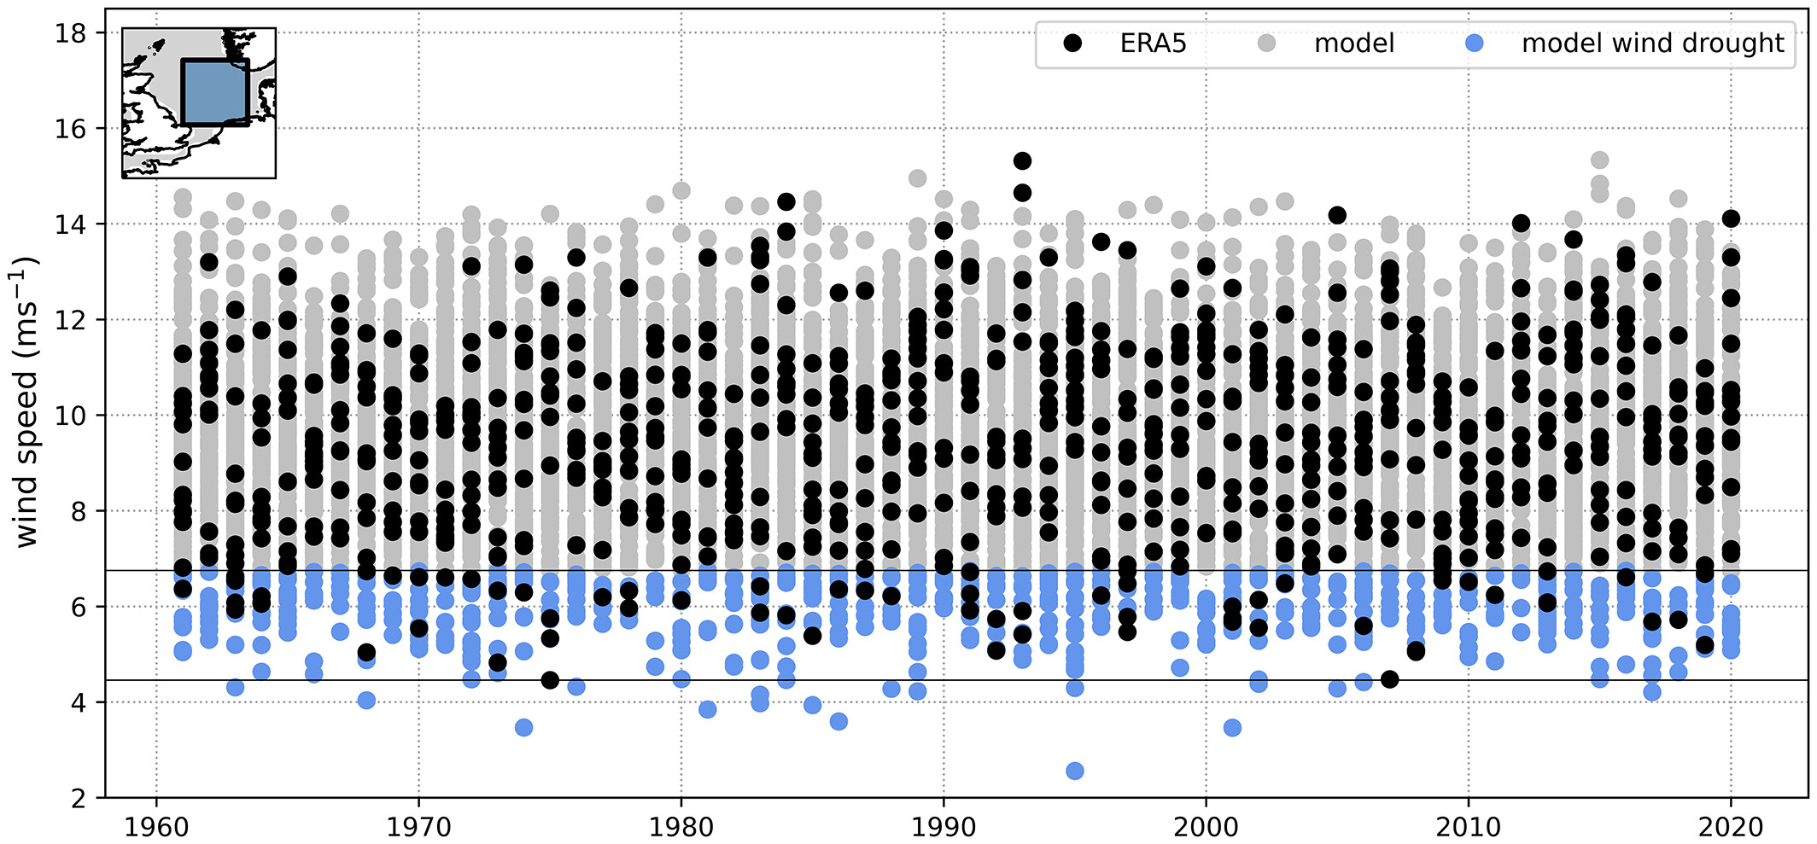
How can we use decadal predictions for extremes?
Weekly mean 10m wind speeds over North Sea (DJF)
Large ensembles -> many samples of plausible weather
UNprecedented Simulated Extremes using Ensembles (UNSEEN)
Better constrain return periods for extremes (e.g. 1-in-50 year, 1-in-100 year)
Kay et al. 2023
Notes:
Limited sample of extremes in historical record
* Wind drought events of up to two consecutive weeks have been observed, but the model indicates a 1-in-40 chance of three or more continuous weeks of wind drought each winter, with the single most prolonged simulated event lasting 5 weeks. – over North Sea region

Slide 12
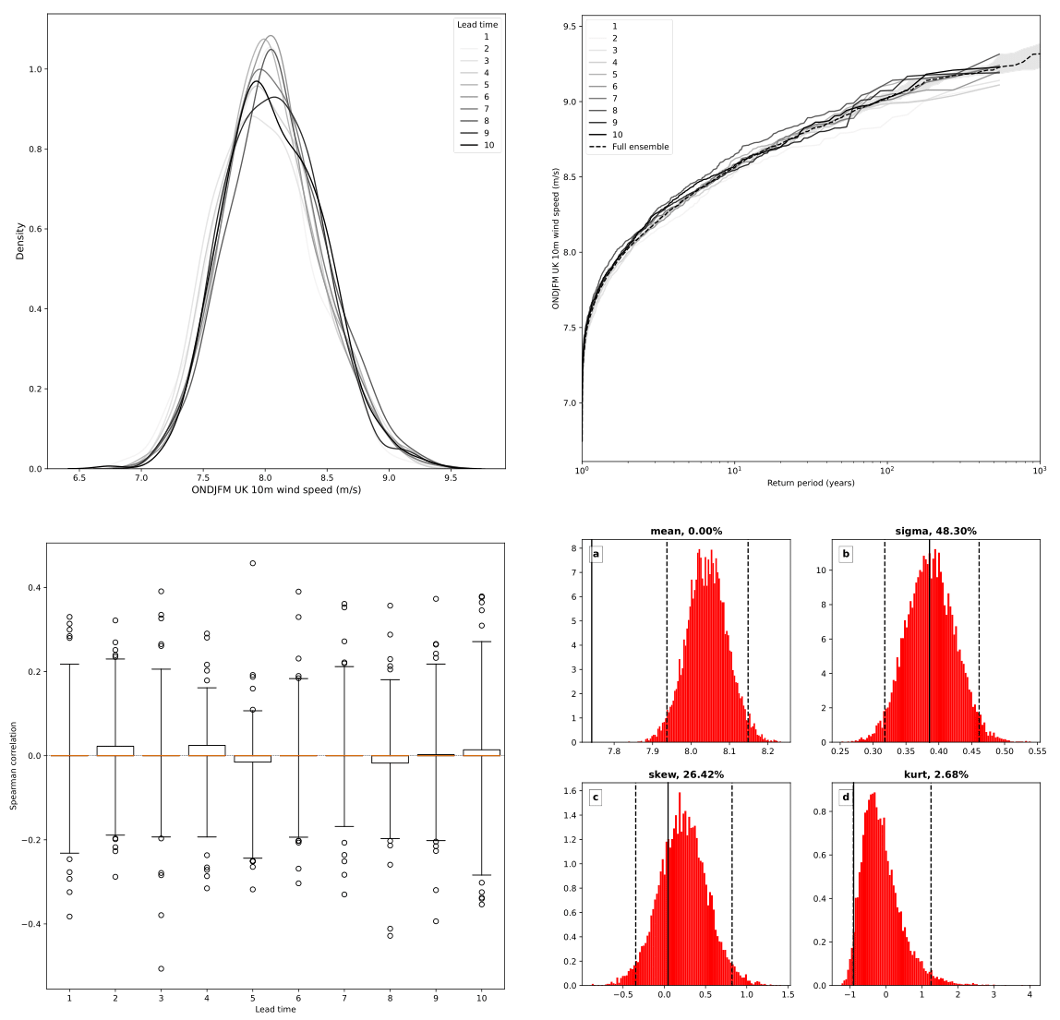
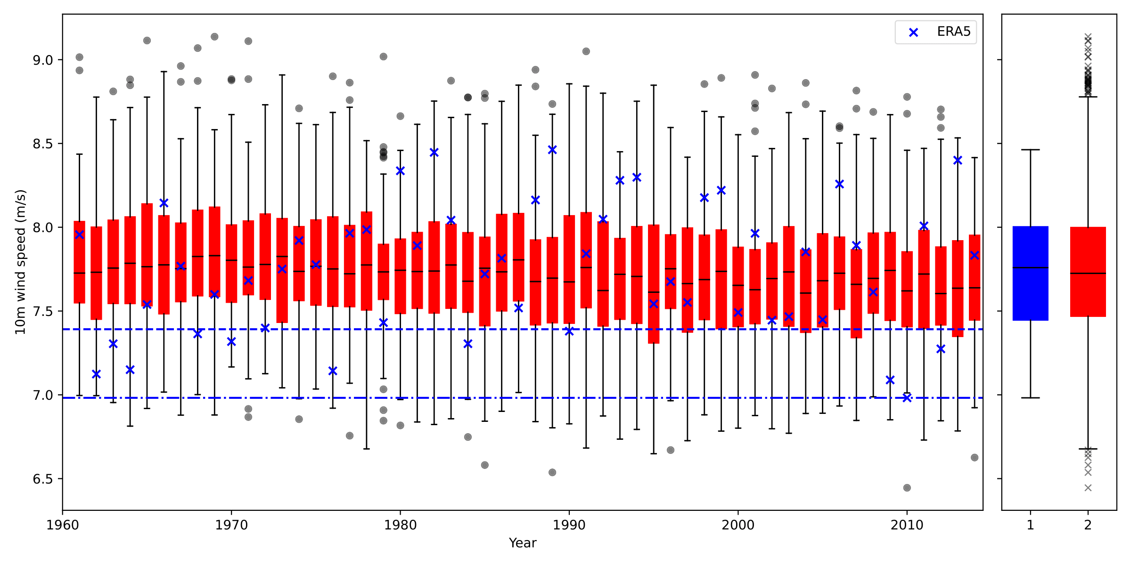
Can we quantify low wind speed winters?
Stability
Seasonal mean 10m wind speeds over UK (ONDJFM)
Verify that model is producing realistic events
Stability
Independence
Fidelity
More samples of extreme winters (beneath 20th percentile)
Unprecedented winters
Independence
Fidelity
Notes:
With greater variable renewable energy resource, we care about prolonged periods of low wind speed on longer (~seasonal) timescales
What do the whiskers of the plot mean?

Slide 13
Overview
Motivation
Decadal forecasts for the energy sector
Decadal predictions for sampling extremes
Challenges
Next steps
Notes:
As we deploy more renewable electricity sources in the power system, such as wind turbines and solar panels, the system becomes more vulnerable to both climate variability and climate change.
Decadal forecasts try to capture signal from both internal climate variability and externally forced signals, so could be useful for the energy-sector
They are initialised with the current state of the atmosphere and oceans each year, in the same way as NWP forecasts
As they are run forward for a decade, they also have prescribed forcings, such as those from greenhouse gases and aerosols, in the same way as climate projections.
Recent work, such as that from Doug Smith in 2020, demonstrated surprising skill for predicting circulation over the North Atlantic, by making skillful predictions of the North Atlantic Oscillation, the pressure gradient over the North Atlantic region
My project looks into whether we can make use of the skill to create decadal predictions for the energy sector
Note that this figure is from Doug’s 2020 paper and therefore different to mine.
Bloomfield, H.C., Brayshaw, D.J., Shaffrey, L.C., Coker, P.J., Thornton, H.E., 2016. Quantifying the increasing sensitivity of power systems to climate variability. Environ. Res. Lett. 11, 124025. https://doi.org/10.1088/1748-9326/11/12/124025
Bloomfield, H.C., Brayshaw, D.J., Troccoli, A., Goodess, C.M., De Felice, M., Dubus, L., Bett, P.E., Saint-Drenan, Y.-M., 2021. Quantifying the sensitivity of european power systems to energy scenarios and climate change projections. Renewable Energy 164, 1062–1075. https://doi.org/10.1016/j.renene.2020.09.125
Smith, D.M., Eade, R., Scaife, A.A., Caron, L.-P., Danabasoglu, G., DelSole, T.M., Delworth, T., Doblas-Reyes, F.J., Dunstone, N.J., Hermanson, L., Kharin, V., Kimoto, M., Merryfield, W.J., Mochizuki, T., Müller, W.A., Pohlmann, H., Yeager, S., Yang, X., 2019. Robust skill of decadal climate predictions. npj Clim Atmos Sci 2, 1–10. https://doi.org/10.1038/s41612-019-0071-y
Smith, D.M., Scaife, A.A., Eade, R., Athanasiadis, P., Bellucci, A., Bethke, I., Bilbao, R., Borchert, L.F., Caron, L.-P., Counillon, F., Danabasoglu, G., Delworth, T., Doblas-Reyes, F.J., Dunstone, N.J., Estella-Perez, V., Flavoni, S., Hermanson, L., Keenlyside, N., Kharin, V., Kimoto, M., Merryfield, W.J., Mignot, J., Mochizuki, T., Modali, K., Monerie, P.-A., Müller, W.A., Nicolí, D., Ortega, P., Pankatz, K., Pohlmann, H., Robson, J., Ruggieri, P., Sospedra-Alfonso, R., Swingedouw, D., Wang, Y., Wild, S., Yeager, S., Yang, X., Zhang, L., 2020. North Atlantic climate far more predictable than models imply. Nature 583, 796–800. https://doi.org/10.1038/s41586-020-2525-0
Boer, G.J., Smith, D.M., Cassou, C., Doblas-Reyes, F., Danabasoglu, G., Kirtman, B., Kushnir, Y., Kimoto, M., Meehl, G.A., Msadek, R., Mueller, W.A., Taylor, K.E., Zwiers, F., Rixen, M., Ruprich-Robert, Y., Eade, R., 2016. The Decadal Climate Prediction Project (DCPP) contribution to CMIP6. Geoscientific Model Development 9, 3751–3777. https://doi.org/10.5194/gmd-9-3751-2016

Slide 14
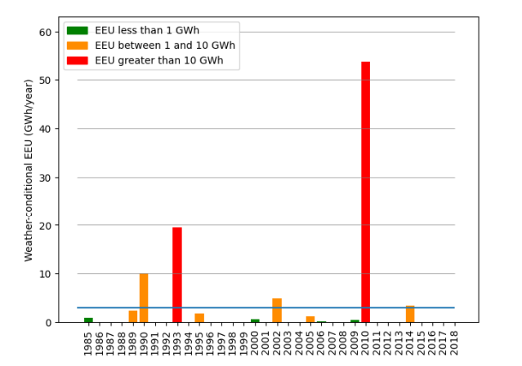
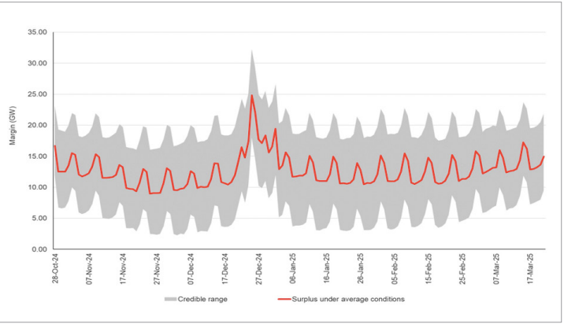
How can these predictions be useful for ESO?
Weather conditional expected energy unserved (EEU)
Margin forecast for winter 2024/25 (ONDJFM)
(Wind gen. + conventional gen.) – demand
Resource adequacy:
Limited sample of historic weather
Winter outlook:
Based on historic weather - no forecast element
ESO, 2024
Notes:
Resource adequacy – assessing potential risks to security of supply and whether there are sufficient available resources to meet demand throughout the year.
RA team in discussion with exploring RA in the 2030s
Two bad years in terms of energy unserved – limited sample of extremes due to limited sample of weather years
34 weather years
Some kind of pictures here

Slide 15
Next steps
Quantify power system stress events using demand-net-renewables.
Evaluate the return period for extreme seasonal to multi-year events (e.g. 2009-2011).
Estimate the size of energy store needed to mitigate extreme events.
Uncertainties:
Challenging event dependent on model power system.
Verifying the extremes generated as plausible.
Notes:
Methodology similar tow Dawkins and Rushby NIC report
Too many words

Slide 16
Next steps
Quantify stress events using demand-net-renewables.
Evaluate the return period for extreme events (e.g. 2009-2011).
Estimate the size of energy store needed to mitigate extreme events.
Extreme events dependent on system modelled
Verifying the simulated extreme events as plausible
Notes:
Methodology similar tow Dawkins and Rushby NIC report

Slide 17
Summary
A power system with more renewables is more vulnerable to changes in weather and climate.
Decadal predictions can be used to forecast how climate variables (e.g. temperature, NAO) will evolve over the next 10 years.
A large ensemble of predictions can be aggregated to create a larger sample of extreme events than are available in observations.
These predictions could be useful for ESO:
For assessing resource adequacy using a large sample of weather years.
For informing season-ahead forecasts of operational margin.

Slide 18

Thank you for listening!
Any questions?
Notes:
Add meme thing

